Slide 1

CRM for BMW
By
Group 8
Mr.Pongraphe Kangsanarak
Ms.Simon Tanquerido Pricilla Faye
Mr.Issaret Prachitmutita
Mr.Nguyen Thai Anh
Mr.Abhinav Asheesh Lugun

Slide 2
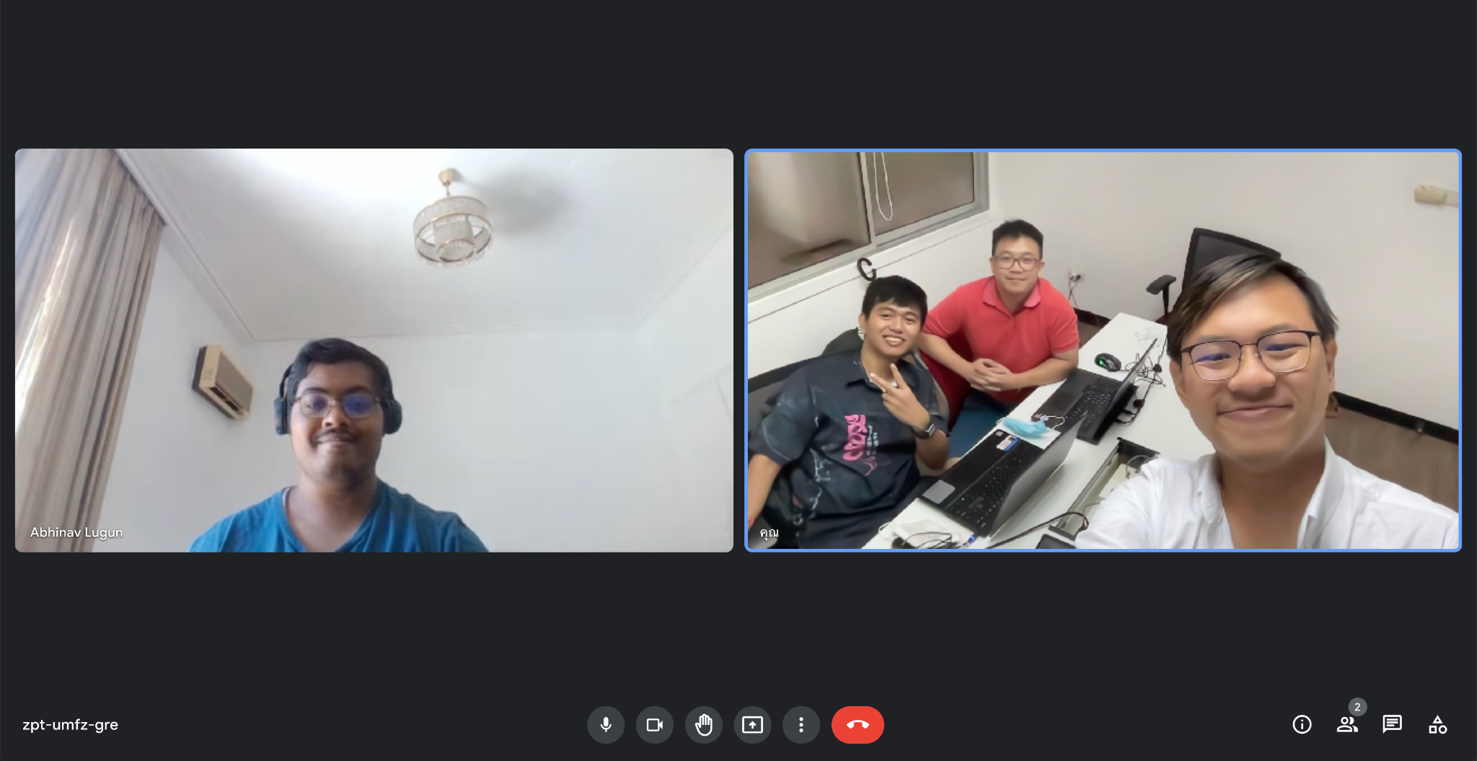


Slide 3
Agenda
Project description
Business Rules
Conceptual Diagram
Logical Diagram
Data Dictionary
Our own SQL

Slide 4
Project description
Our goal in creating a customer relationship management system (CRM) for the BMW showroom is to digitally transform the business by concentrating on the two areas of management, and maintenance. Such as
Dashboard for executive
Sale statistics
Purchase and repair history
Repair Performance
Management system for maintenance team.
Accident History
Repair History
Spair parts inventory
Mechanic Team
Customer History
Purchase Order Transaction
Vehicle History
Warranty tracking

Slide 5
Business Rules
In each of purchase order, our business only order one part number per model.
Each repair job has estimated time for repair tasks completion.
Warranty will cover only the spare part separately.
Customer can track the current repair status of his/her vehicle
Each repair job can have many repair detail
Each repair detail represent repair part. lists a vehicle part added and its cost, cost of service, description of repair, mechanics working on it, and the current repair status
Repair job is completed when all its separate repair detail takes are also completed

Slide 6
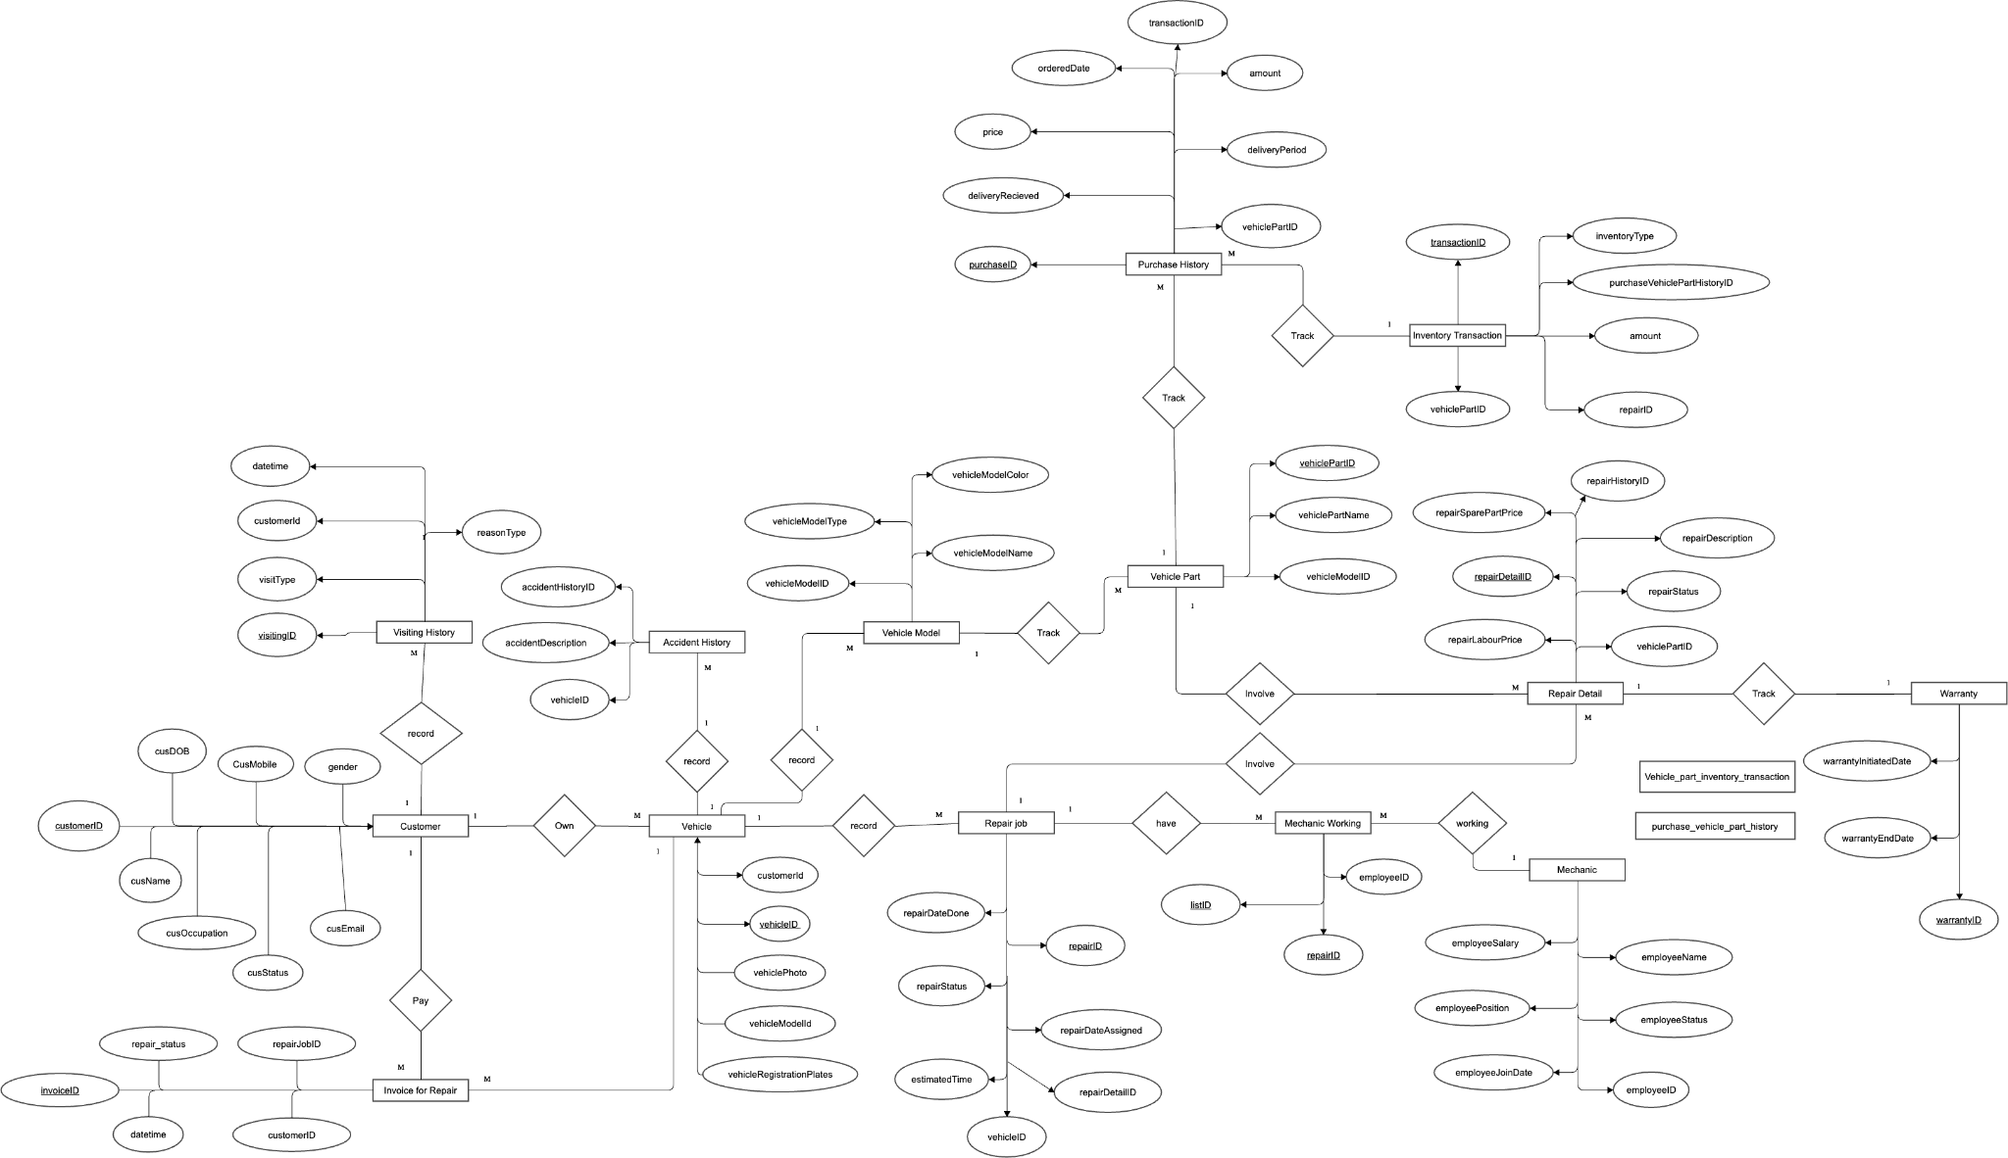
Conceptual Diagram

Slide 7
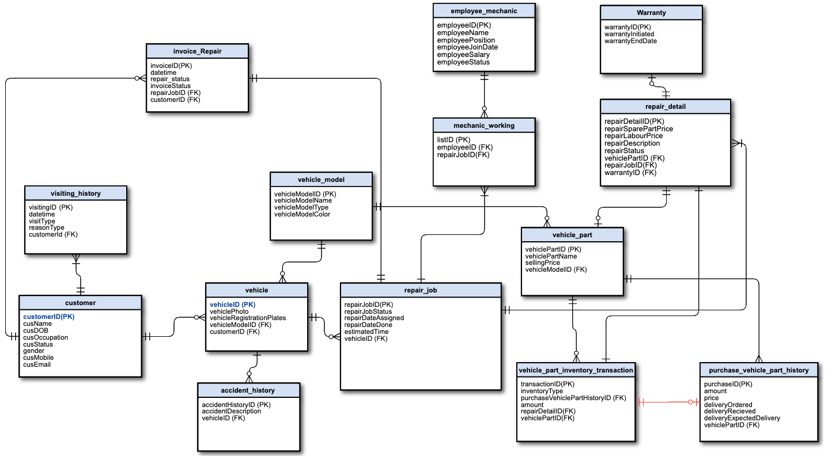
Logical Diagram

Slide 8
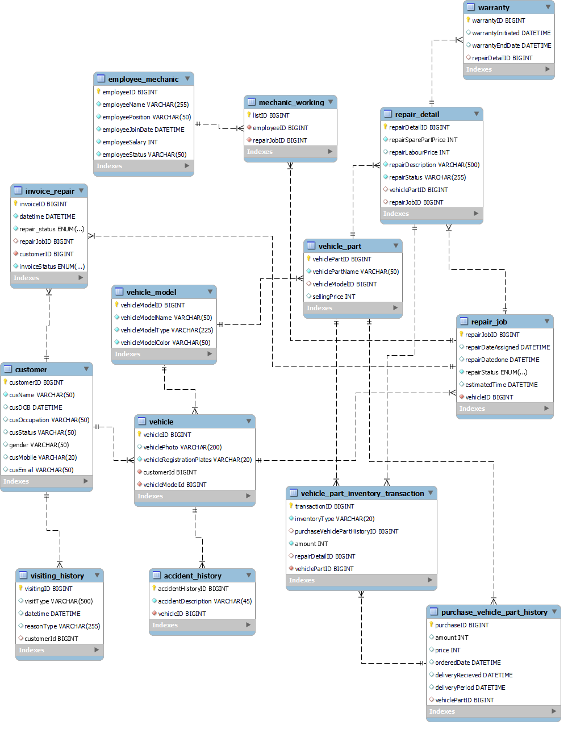
EER Diagram

Slide 9
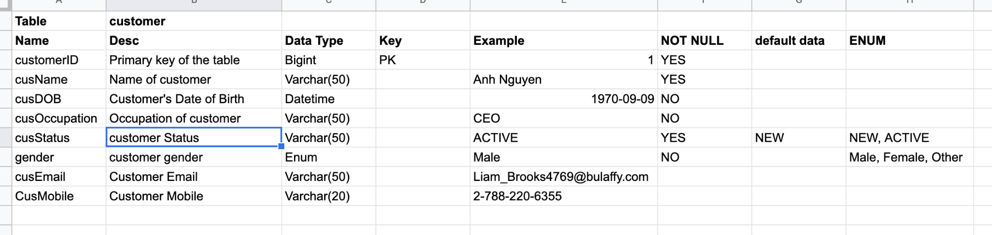
Data Dictionary
https://docs.google.com/spreadsheets/d/1nUT6rXyere1OPQ2KlfNvv8kn-oo1lTV95m8wuF6OK3c/edit?usp=sharing

Slide 10
Issaret
The staff welcomes customers who visit and advises the prices of their car repairs. Some people may ask the price and use the service. Some people may not use the service.
Onboarding a new client who wants to use repair services for their customer who never has any record with our company.
The manager would like to know how many client came to the shop and not repair?
The manager would like to know their employee efficiency and performance.
Including Which car that is broken and come to be repaired again after it was repaired no more than 1 month ago?
Who is the fastest mechanic to fix the car?

Slide 11
Issaret
The executive would like to know which car model is the most profitable for spare parts margin in average ?
The exeuctive would like to know in the last 3 months which car model doesn't make much money at all?
The manager of inventory whould like to report to his executive that which car model has the longest wait for parts to be repaired?

Slide 12
Issaret
The staff welcomes customers who visit and advises the prices of their car repairs. Some people may ask the price and use the service. Some people may not use the service.
Steps:
INSERT a new customer data, if does not exisit.
UPDATE a new data of customer, in case of their have any change.
INSERT record to visiting_history table

Slide 13
Issaret
The manager would like to know how many client came to the shop and not repair?
Steps:
SELECT the details of client came to the shop and not repair?
Notes:
Since the database was designed for this business case, SQL query can be very simple.

Slide 14
Issaret
The manager would like to know their employee efficiency and performance.
Including Which car car that is broken and come to be repaired again after it was repaired no more than 14days ago?
Who is the fastest mechanic to fix the car?
Steps:
Select to find which car that is have more than 2 repair jobs for repair the same details within 1 month?
Select to find the mechanic who have the est average time to repair a car.

Slide 15
Select to find which car that is have more than 2 repair jobs for repair the same details within 1 month?
Changing mocking data for this case.
From
To

Slide 16
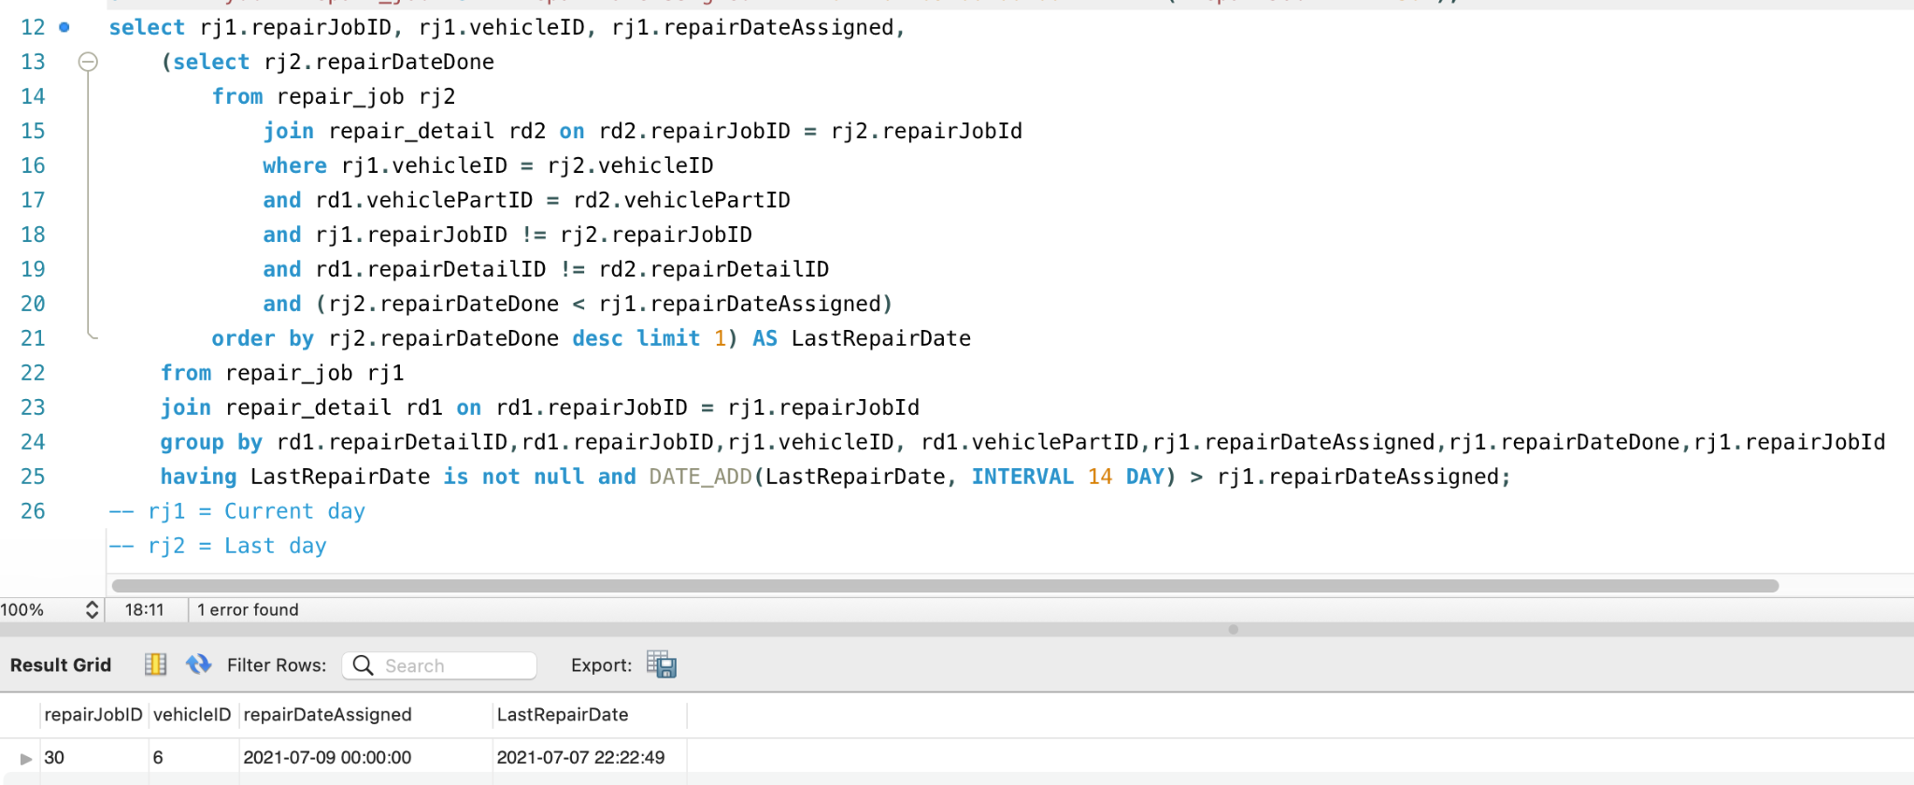
Select to find which car that is have more than 2 repair jobs for repair the same details within 1 month?

Slide 17
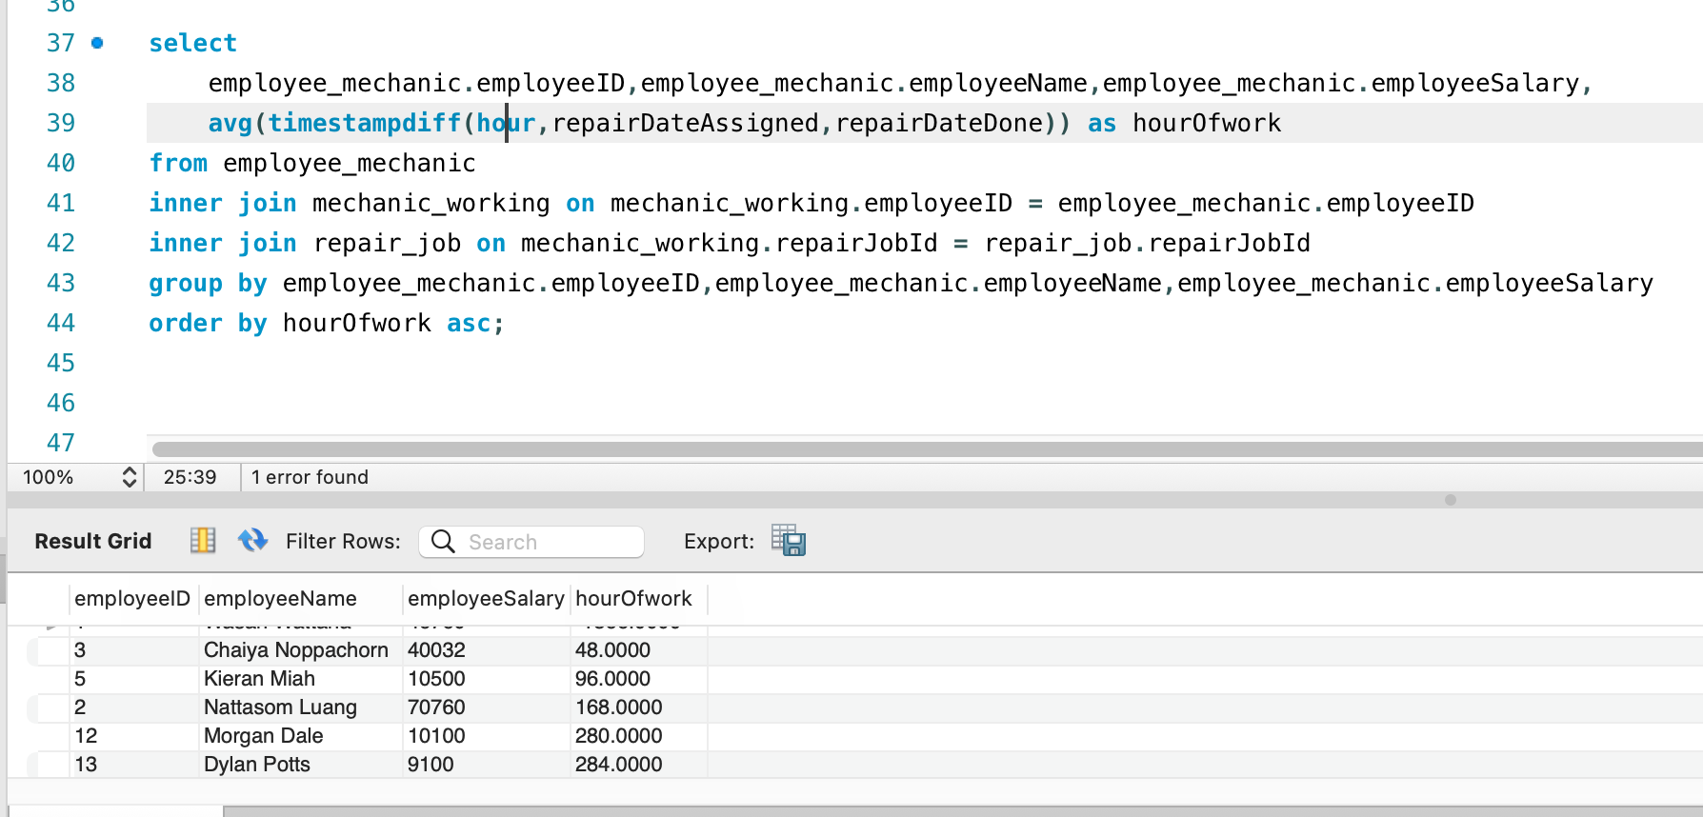
Who is the fastest mechanic to fix the car?

Slide 18
Issaret
The executive would like to have a dashboard for his business
Steps:
3. which car model is the most profitable for spare parts margin in average ?
4. In the last 3 months, which car model doesn't make much money at all?

Slide 19
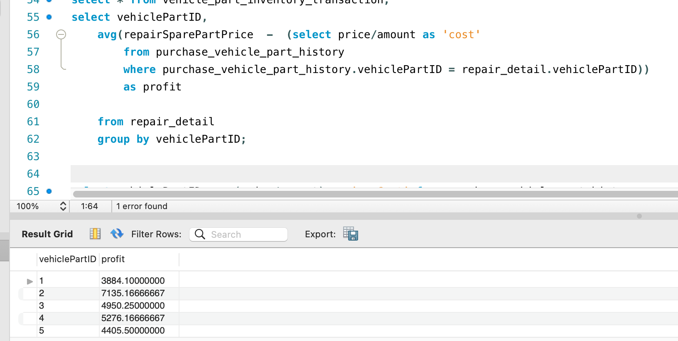
which car model is the most profitable for spare parts margin in average ?

Slide 20
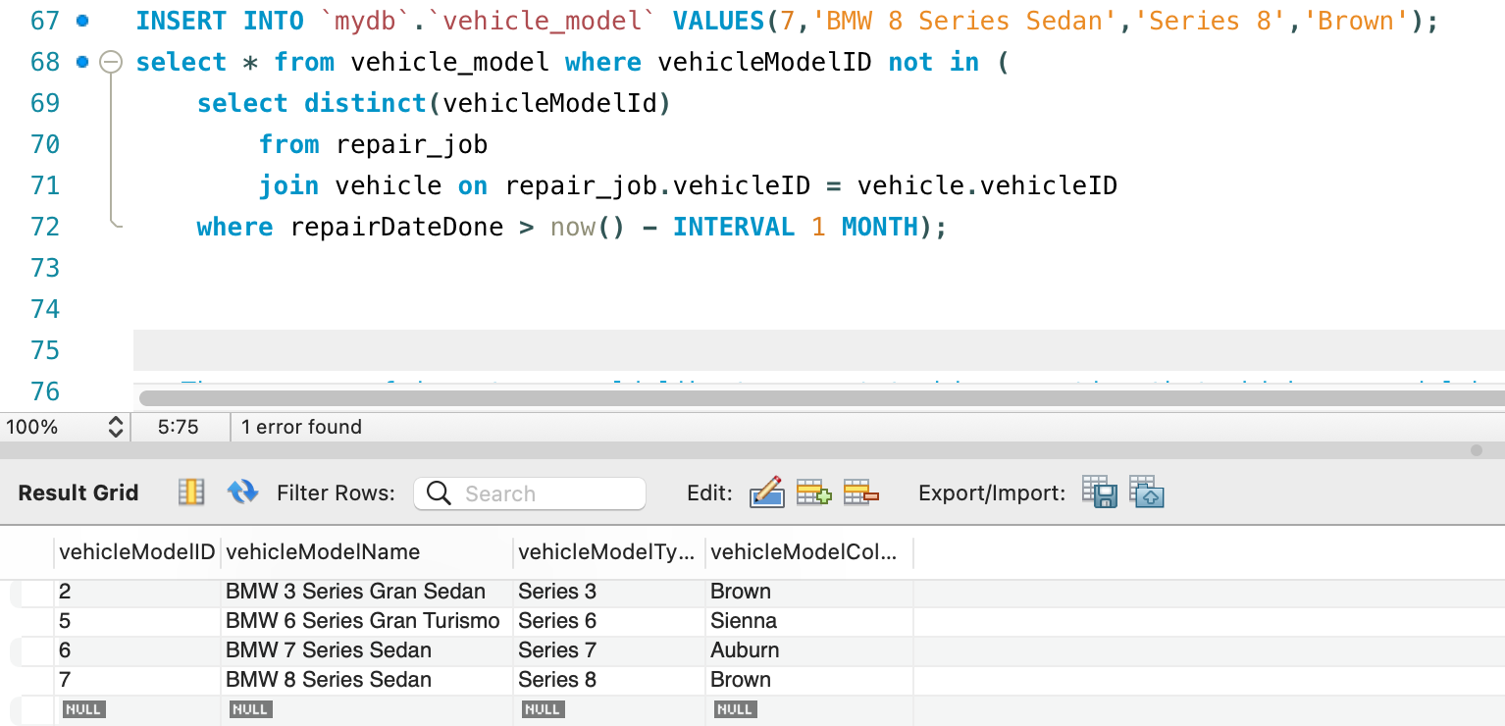
In the last 3 months, which car model doesn't make much money at all?

Slide 21
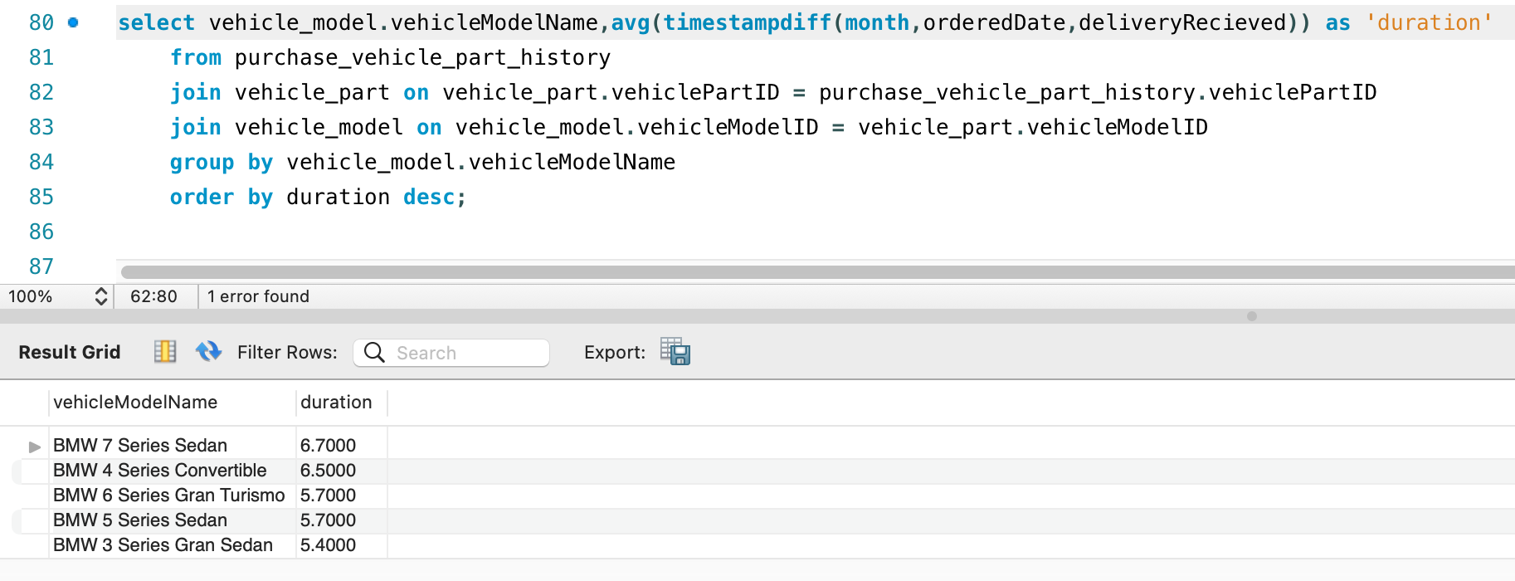
Issaret
5. The manager of inventory would like to report to his executive that which car model has the longest wait for parts?

Slide 22
Issaret
The staff welcomes customers who visit and advises the prices of their car repairs. Some people may ask the price and use the service. Some people may not use the service.
Steps:
INSERT a new customer data, if does not exisit.

Slide 23
Issaret
The staff welcomes customers who visit and advises the prices of their car repairs. Some people may ask the price and use the service. Some people may not use the service.
Steps:
2.UPDATE a new data of customer, in case of their have any change.

Slide 24
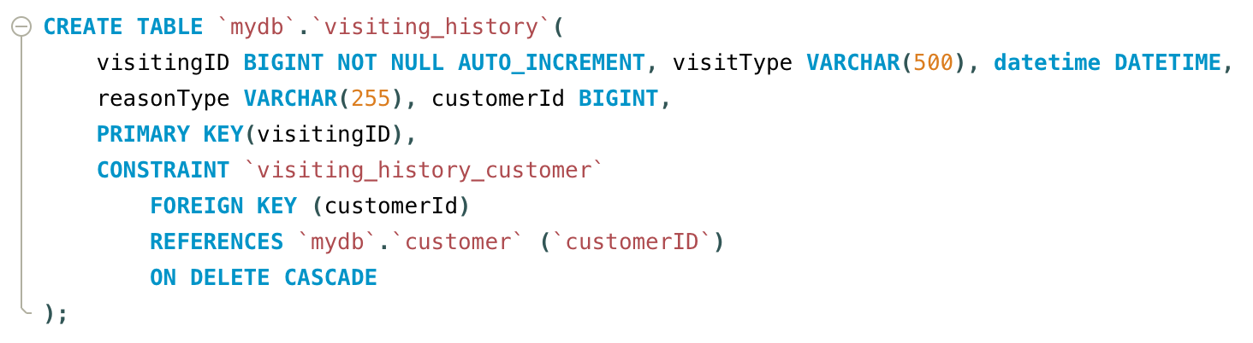
Issaret
3. INSERT record to visiting_history table

Slide 25
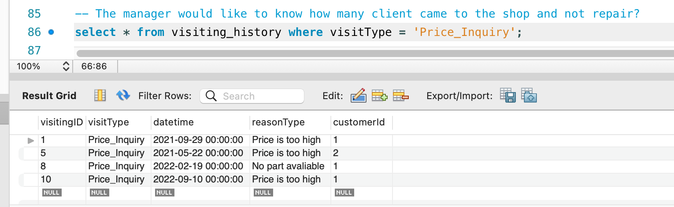
The manager would like to know how many client came to the shop and not repair?

Slide 26
AOF
Scenario: Customer want to know the repair prices
Background: A new customer wants to change his door seal strips and the customer wants to know the price before repair. The seal strip needs to be changed due to old age. The vehicle is …
Steps:
1. Check the the customer, old or new, using full name and insert their infor eg. visites and customer’s info .
2. Insert vehicle and customer information
3. Check the part available in the inventory for the given vehicle
4. Check the price of the part.
5. Insert the spare price to Invoice.

Slide 27
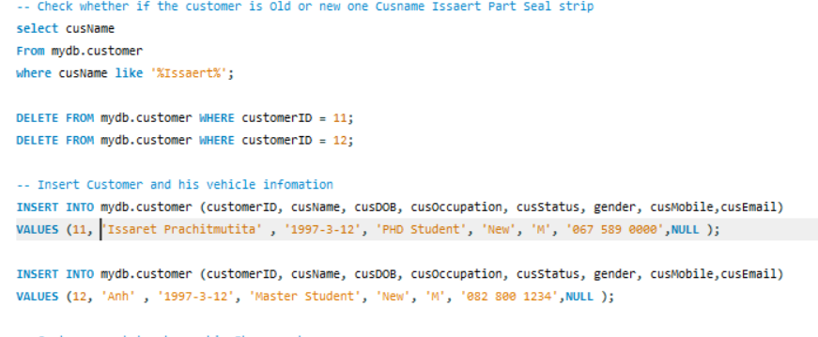
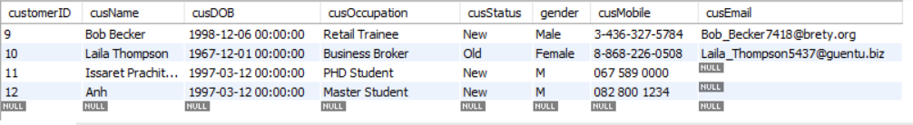
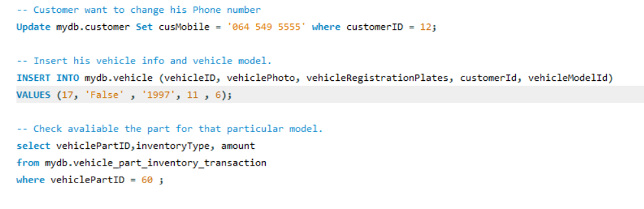
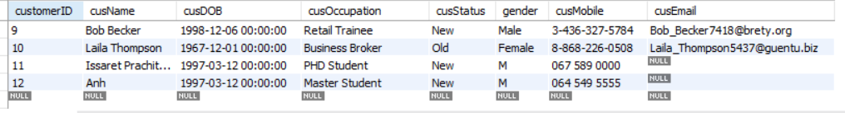
Scenario: Customer want to know the repair prices
AOF

Slide 28
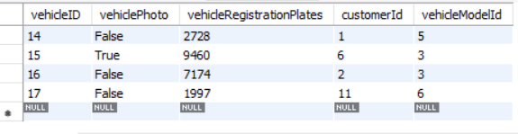
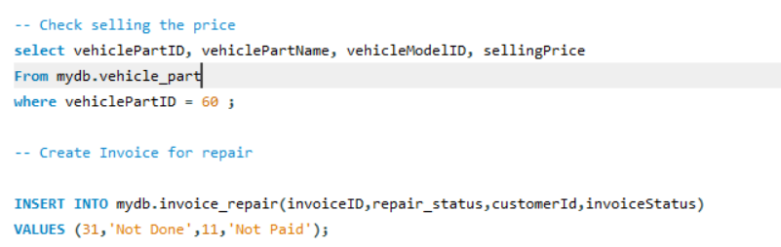
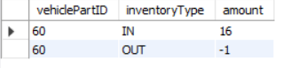
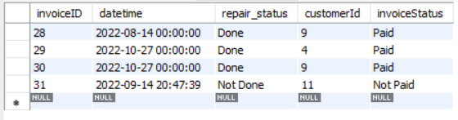
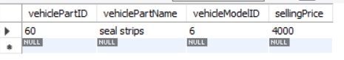
Result
AOF

Slide 29
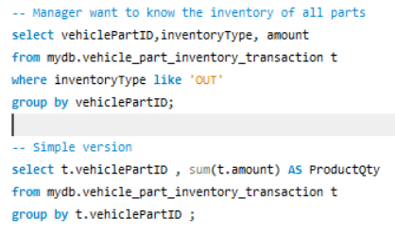
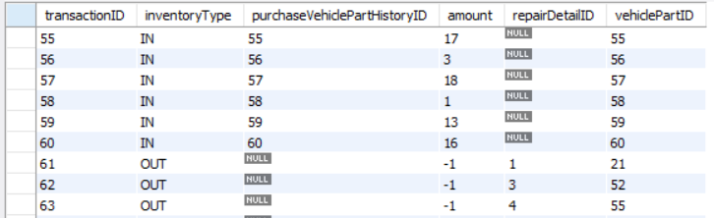
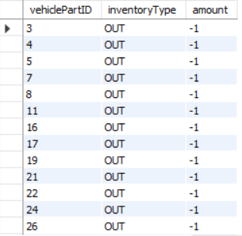
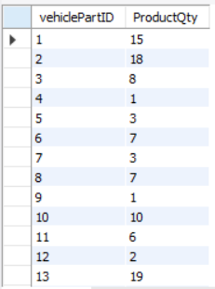
Scenario: Manager want to know final inventory
AOF

Slide 30
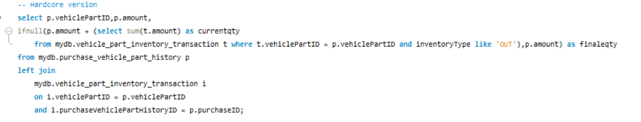
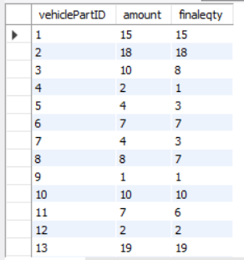
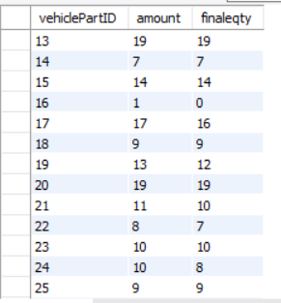
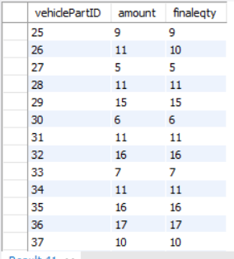
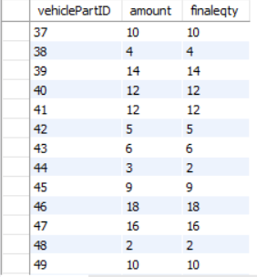
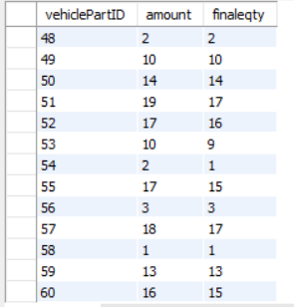
AOF
Scenario: Manager want to know final inventory

Slide 31
Anh
UPDATE `mydb`.`repair_job` SET `repairDatedone` = '2022-05-10', `repairStatus` = 'done' WHERE (`repairJobID` = '6');
Create a invoice when the car is repaired
INSERT INTO `mydb`.`invoice_repair` (`invoiceID`, `datetime`, `repair_status`, `customerID`, `invoiceStatus`) VALUES ('31', '2022-05-11', 'Done', '10', 'Paid');

Slide 32
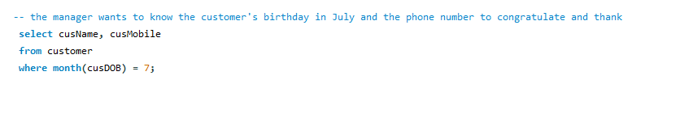
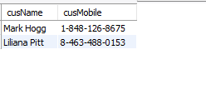
Anh
The manager wants to know the customer's birthday in July and the phone number to congratulate and thank

Slide 33
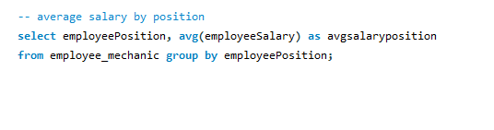
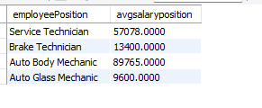
Anh
Average salary for each position

Slide 34
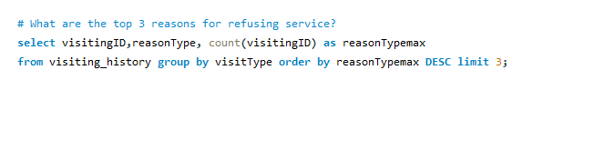
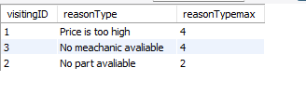
Anh
What are the top 3 reasons customers refuse service the most?

Slide 35
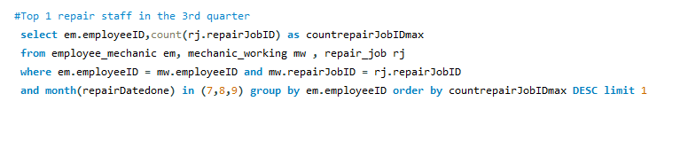
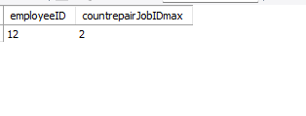
Anh
Top 1 repair staff in the 3rd quarter (The employee have the most repaired work done in the quarter)

Slide 36
Abhinav
Scenarios:
A manager wishing to know which vehicle parts to order more
Customer seeing a detailed report of his/her vehicle repair

Slide 37
Scenario: Ordering Vehicle Parts
Description:
As the manager, I would like to know which vehicle parts to order more based on current repair demand
Questions to answer:
Which repair problems are most common?
Which vehicle spare parts are most used?

Slide 38
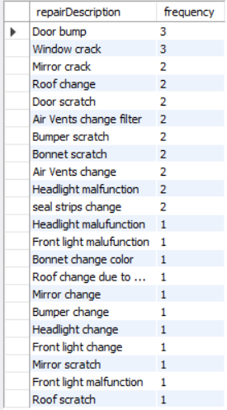
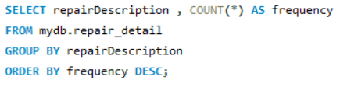
Scenario: Ordering Vehicle Parts (2)
Which repair problems are most common?

Slide 39
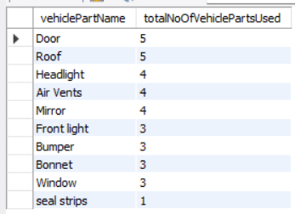
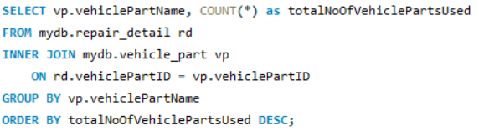
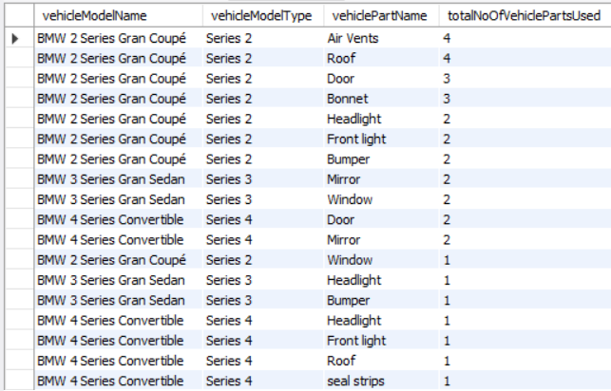
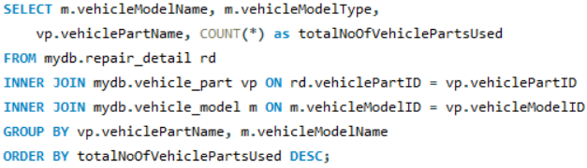
Scenario: Ordering Vehicle Parts (3)
Which vehicle spare parts are most used?
By total vehicle part:
By vehicle model:

Slide 40
Scenario: Ordering Vehicle Parts (4)
Conclusion:
Order more vehicle parts for BMW 2 Series Gran Coupé
Order more vehicle parts related to door, roof, and air vents

Slide 41
Scenario: Report of Vehicle under Repair
Description:
As a customer, I want to get a detailed report of my vehicle(s) under repair
Customer:
Liam Brooks with customerId = 3
Queries:
Report of vehicle with details of each repair task
Report of vehicle of total cost, estimated repair completion

Slide 42
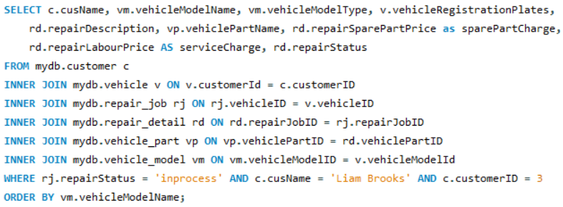
Scenario: Report of Vehicle under Repair (2)
Report of vehicle with details of each repair task

Slide 43
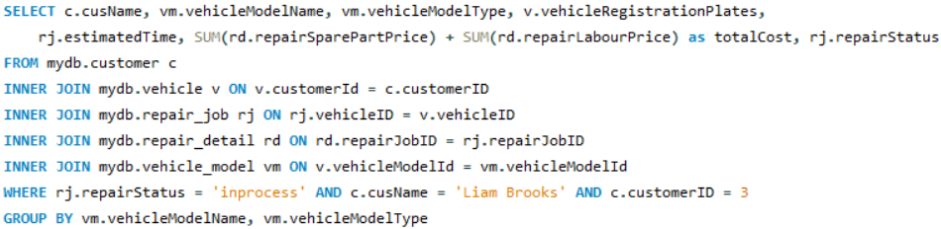
Scenario: Report of Vehicle under Repair (3)
Report of vehicle of total cost, estimated repair completion

Slide 44
Faye
The manager would like to know the following information:
What is the most common repair done to cars?
What part is the most commonly changed
Which is the most expensive service they could do (excluding price of vehicle part)
Who is the most requested mechanic? (mechanic with most jobs done)

Slide 45
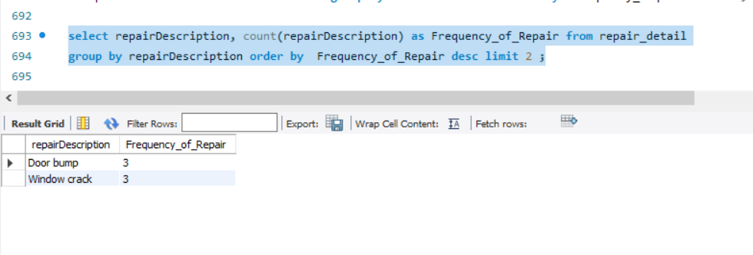
1.What is the most common repair done to cars?
Query:
select repairDescription, count(repairDescription) as Frequency_of_Repair from repair_detail
group by repairDescription order by Frequency_of_Repair desc limit 2 ;
Result

Slide 46
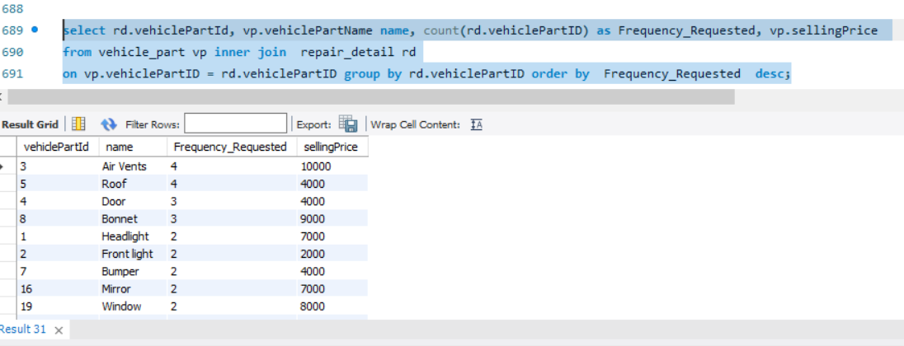
2. What part is the most commonly changed
Query:
select rd.vehiclePartId, vp.vehiclePartName name, count(rd.vehiclePartID)
as Frequency_Requested, vp.sellingPrice
from vehicle_part vp inner join repair_detail rd on vp.vehiclePartID = rd.vehiclePartID group by rd.vehiclePartID order by Frequency_Requested desc;
Result

Slide 47
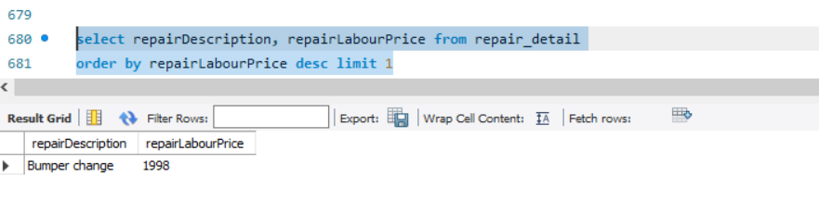
3. Which is the most expensive service they could do (excluding price of vehicle part)
Query:
select repairDescription, repairLabourPrice from repair_detail
order by repairLabourPrice desc limit 1
Result

Slide 48

4. Who is the most requested mechanic? (mechanic with most jobs done)
Query:
select em.employeeID, em.employeeName, em.employeePosition, count(mw.employeeID) as Frequency_Requested
from mechanic_working mw inner join employee_mechanic em
on em.employeeID = mw.employeeID group by em.employeeID order by Requested desc;
Result

Slide 49
Thank you

